Slide 1



Cyber Threat Analysis
Nirbhay Singh Naruka, Viswadatta Chinta,
Prit Shah, Pranav Upadhyaya

Slide 2
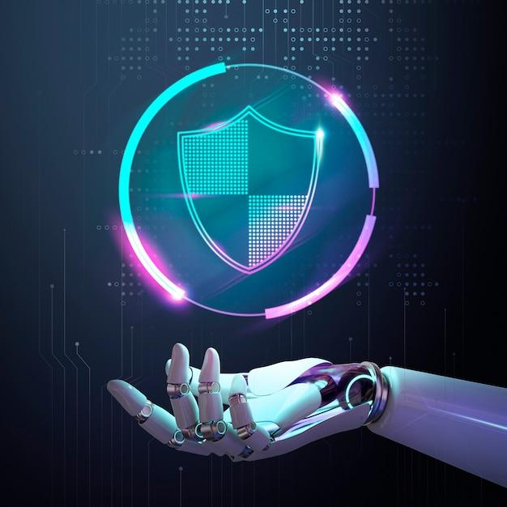
Introduction
Cyber threats are attempts by individuals, groups, and organizations to breach the information systems of another.
Notes:
These attacks aim to damage, disrupt, or gain unauthorized access to computer systems, networks, or devices, often with malicious intent.

Slide 3
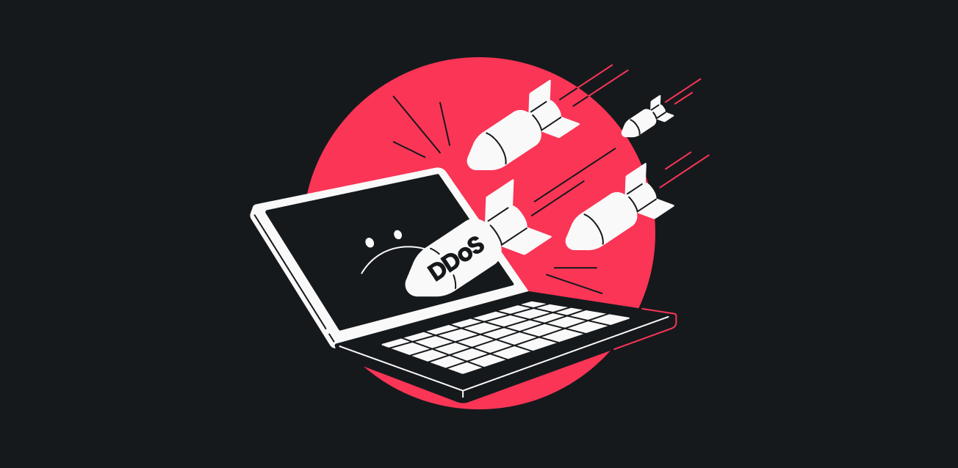
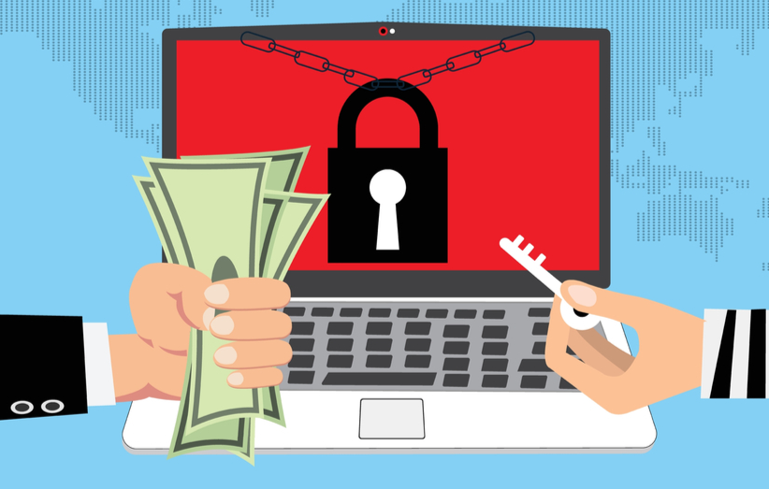
Types Of Cyber Attacks
OWASP attacks
Cross-site Scripting
SQL Injection
Command injection
Path Traversal
Content spoofing
Cache poisoning
DDoS
Ransomware
To Disrupt services by flooding requests to host networks
Encrypts critical data by the use of malwares through phishing attacks demanding ransom.
Notes:
common attacks - DDoS, OWASP, Automated Threat
15 more types of attacks
this OWASP attacks are different kind of attacks which we found
This are the main common attacks

Slide 4

Hypothesis 1
Developed countries are more susceptible to cyber attacks than others due to their geopolitical significance, economic status, cyber infrastructure development, legal and regulatory frameworks.
Notes:
Certain regions or countries are more frequently targeted by cyber attacks than others, possibly due to geopolitical reasons, the concentration of tech companies, or varying levels of cybersecurity defenses.

Slide 5
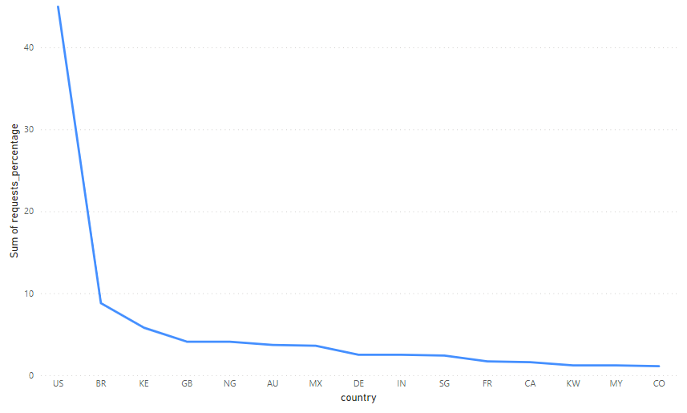
Countries being attacked
Notes:
Certain regions or countries are more frequently targeted by cyber attacks than others, possibly due to geopolitical reasons, the concentration of tech companies, or varying levels of cybersecurity defenses.
US: United States, BR: Brazil, KE: Kenya, GB: United Kingdom, NG: Nigeria, AU: Australia, MX: Mexico, DE: Germany, IN: India, SG: Singapore, FR: France, CA: Canada, KW: Kuwait, MY: Malaysia, CO: Colombia

Slide 6
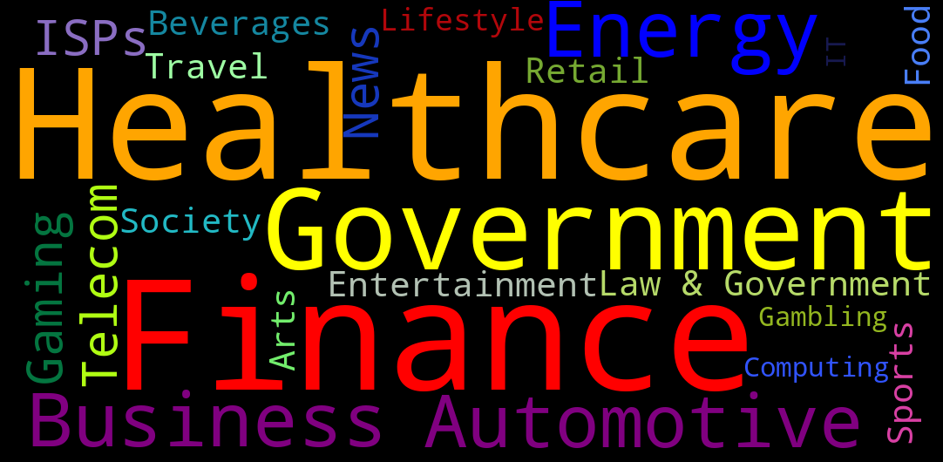
Sectors
Notes:
Total number 19 sectors or industries get affected
common industries - Gaming', 'Telecom and ISPs', 'Automotive', 'Education', 'News', 'Entertainment & the Arts', '', 'Financial Services', 'Business', 'Law & Government', 'Sports', 'Healthcare', 'Retail', 'Travel', 'Food & Beverages', 'Society', 'Lifestyle', 'Computing & IT', ', 'Gambling', 'Adult'
wHEN WE ENDED IUP WITH SMALL DATASET THIS WERE DISTINCT SECTOR THAT HAVE CONSTATNT ATTACKED CYBER AND HENCE WE CAME UO WITH HYPO AND THIS SECTORS ARE AFFECTED MORE THAN OTHER:

Slide 7
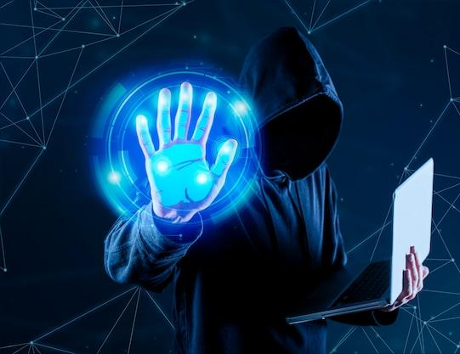
Hypothesis 2
Certain sectors (e.g., healthcare, finance, government, energy) are more susceptible to cyber attacks than others due to the value of the data they hold, their role in national infrastructure, or varying levels of cybersecurity defenses they possess.
Notes:
Hypothesis: Critical infrastructure sectors (e.g., healthcare, finance, energy) are targeted more and suffer greater impacts from cyber-attacks compared to other sectors.

Slide 8

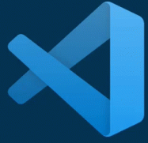


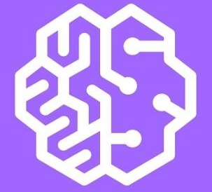
AWS Cloud Services
We are utilizing AWS to efficiently process large volumes of data, perform in-depth analysis, and generate insightful visualizations on cyber threats.
To write and deploy code that interacts with AWS services.
To write a function to call the API and process the data.
To store the retrieved data
Alternate of VS Code - Sagemaker.

Slide 9

Data Source and Integration
IMPERVA, an American cyber security software and services company which provides protection to enterprise data and application software.
APIs have access to the GZIP data for each day, and we are thinking of accessing the week’s data each time we run the analysis.
01
02
03
Load
Extract
Transform
Retrieve data through API links and process GZIP files with AWS Lambda.
Prepare and clean data for analysis.
Store and manage data using Amazon S3 and additional AWS services.

Slide 10

Analyze threat level by region and sector
Map out the origins and targets of attacks to identify hotspots and analyze any correlations with political, economic, or social factors.
Explore protocols that would be effective in preventing attacks
Next steps
Notes:
Cyber threats are an ever-present danger in our increasingly digital world, necessitating vigilant cybersecurity measures for protection. These threats, ranging from malware to phishing and DDoS attacks, target individuals and organizations alike, aiming to steal sensitive information, disrupt operations, or cause financial harm. By adopting robust cyber security protocols, such as regular updates, user education, and employing advanced security technologies, we can mitigate the risk of cyber attacks and safeguard our digital assets against unauthorized access or damage.

Slide 11
Thank You!

